Slide 1







CAPSTONE PROJECT - FINAL PRESENTATION
EBAI BENJAMIN MENGOT
08-07-2023

Slide 2



OUTLINE
Executive Summary
Introduction
Methodology
Results
Visualization – Charts
Dashboard
Discussion
Findings & Implications
Conclusion
Appendix

Slide 3

EXECUTIVE SUMMARY
Trends in demands for types of Programming Language skills indicate constant upskilling is advisable.
Trends in demands for types of Databases indicate a reasonably stable demand in the Top 10 Databases.
Men vs Women Demographics in Tech.
Age Demographics in Tech.

Slide 4

INTRODUCTION
Programming Languages reviewed.
Database types reviewed.
Platforms reviewed.
WebFrames reviewed.

Slide 5

METHODOLOGY
Data collection via Python API.
Data collection via Python Web Scraping.
Data cleaning and wrangling with SQL commands within Python.
Data analysis with Python panada and numpy libraries.
Data visualization using Python libraries Matplotlib and Seaborn.
Bar Charts
Pie Charts
Line Charts
Map Charts
Word Charts

Slide 6
RESULTS

Slide 7
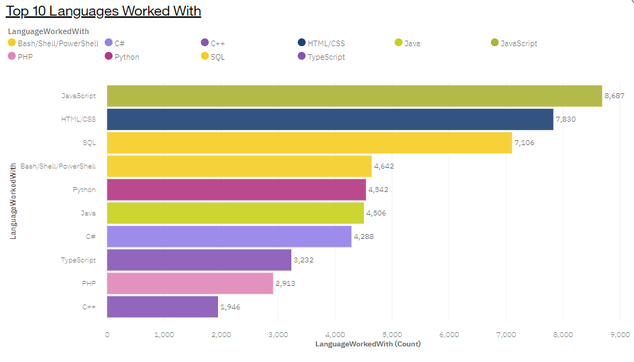
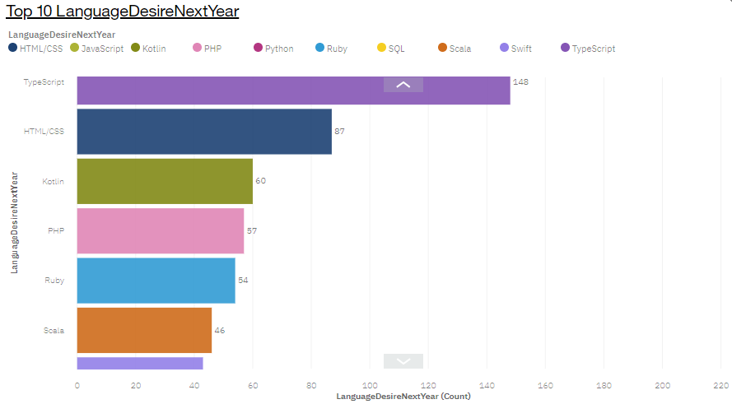
PROGRAMMING LANGUAGE TRENDS
Current Year
Next Year

Slide 8
PROGRAMMING LANGUAGE TRENDS - FINDINGS & IMPLICATIONS
Findings
The Top 10 Languages used in the current year are different to the Top 10 Languages desired to be learnt next year.
HTML/CSS and PHP are consistently in the Top 10 for current and next “desired” year.
The number of datapoints in the DesireNextYear data is significantly less than the current year data.
Implications
Programmers without the knowledge of the Top 10 desired languages should make plans for relevant training.
HTML/CSS and PHP seem to indicate current and future demand trends. Potential growth in demand for these skills.
The DesireNextYear data may not be sufficient for predicting future skills demand trends.

Slide 9
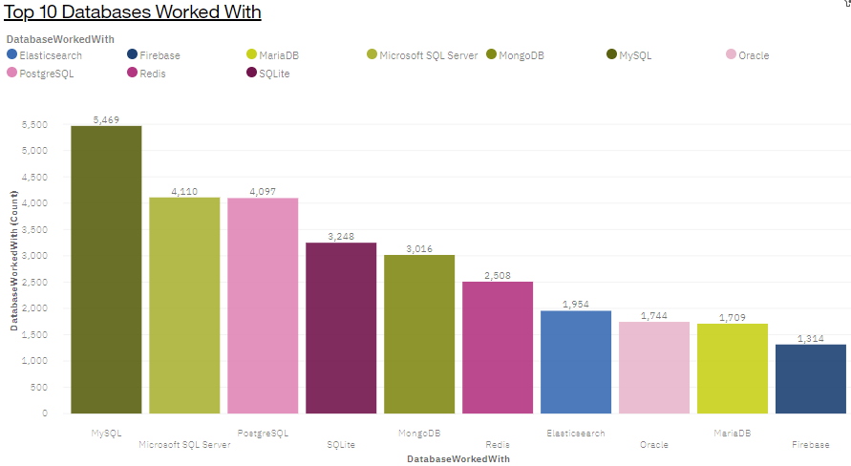
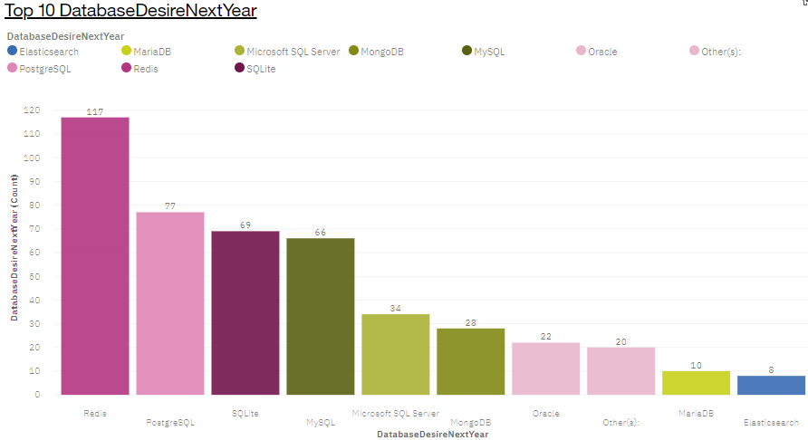
DATABASE TRENDS
Current Year
Next Year

Slide 10
DATABASE TRENDS - FINDINGS & IMPLICATIONS
Findings
9 of the 10 Databases are on the list for both years.
The ordering of the Databases on the lists of both years are different.
The number of datapoints in the DesireNextYear data is significantly less than the current year data.
Implications
There seems to be a consistent demand in the Top 10 types of Database.
It is still worth upskilling to familiarize oneself with the top Databases on next year’s demand list.
The DesireNextYear data may not be sufficient for predicting future skills demand trends.

Slide 11

DASHBOARD
https://eu-gb.dataplatform.cloud.ibm.com/dashboards/c5878157-8d3d-4dd9-a51c-87f51c28eda0/view/053df77866ed39e914fdbde407917f5728657109b3bb850ad2817b4959662097f0691ac2c82b4e0fd8155136f0e9410ac9

Slide 12
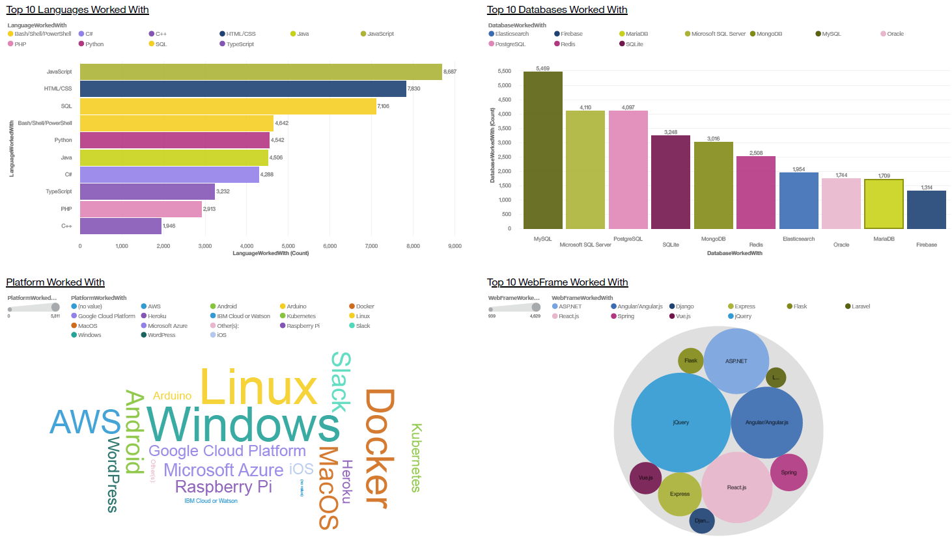
DASHBOARD TAB 1

Slide 13
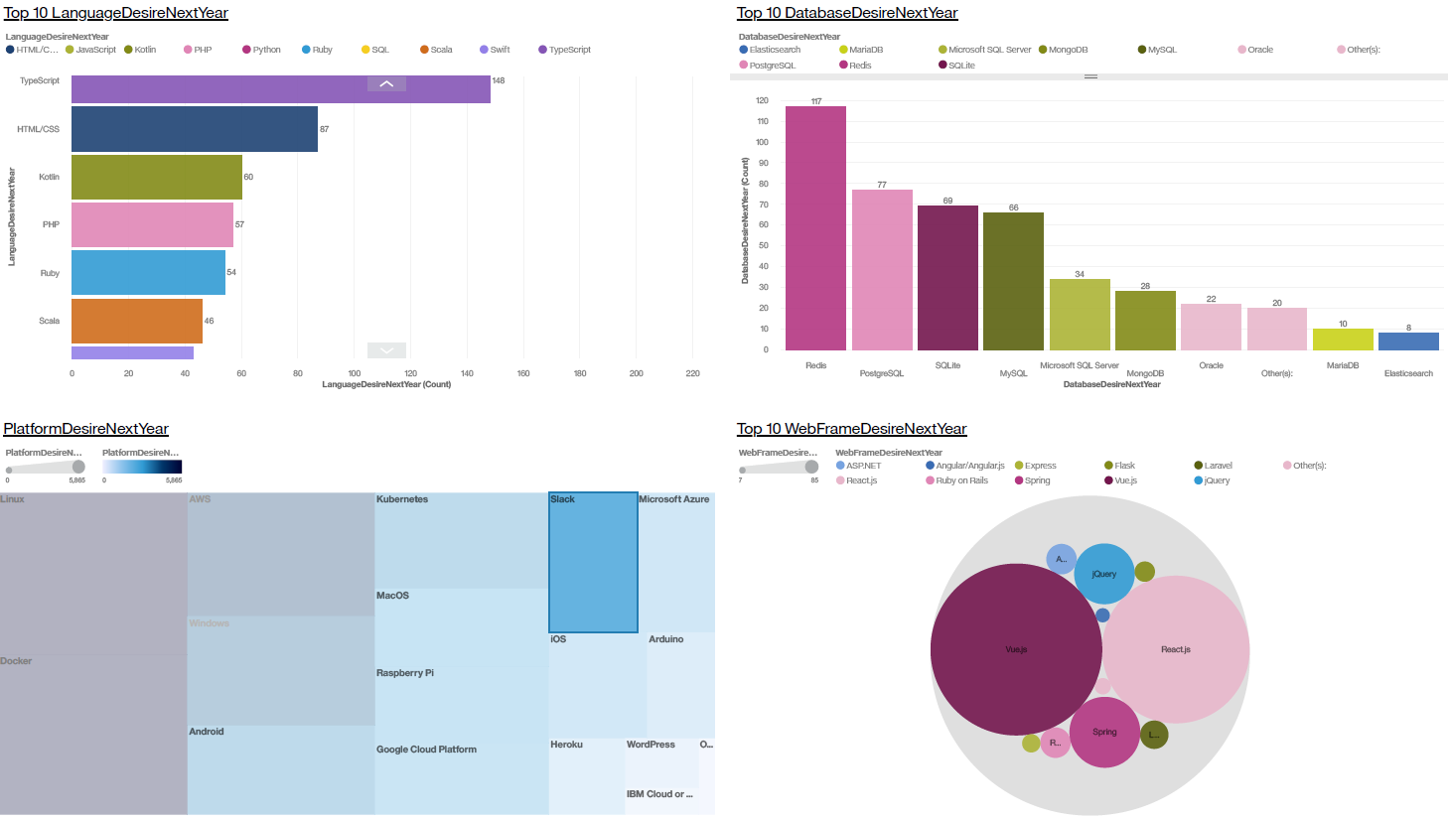
DASHBOARD TAB 2

Slide 14
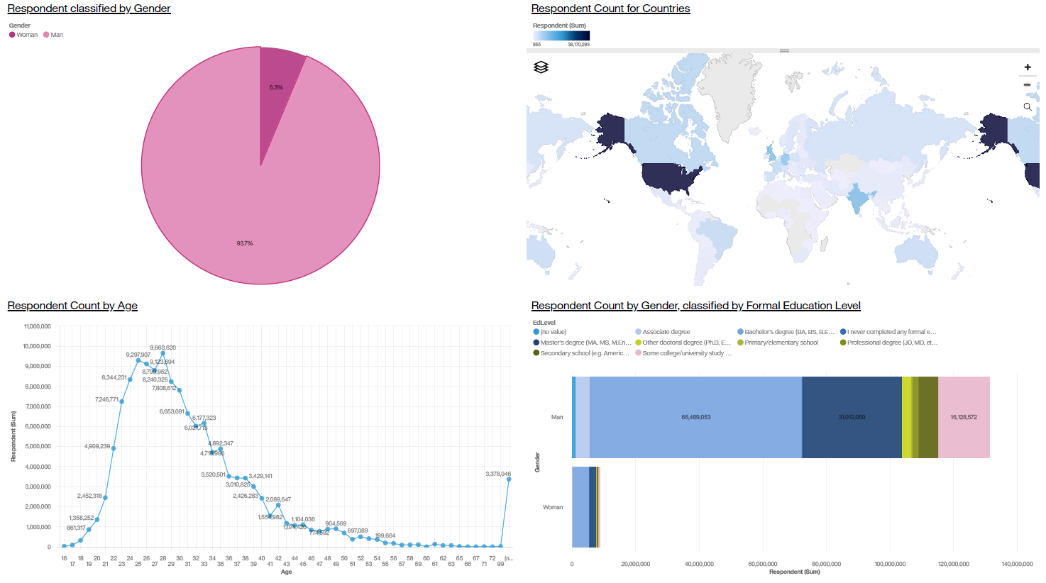
DASHBOARD TAB 3

Slide 15
DISCUSSION
There does not seem to be a be-all-end-all Programming language to learn. It is advisable to constantly upskill to stay with the demand trends.
There seem to be a stable Top 10 of in-demand Databases. Familiarity with at least half of these will keep one on the right side of skills demands.
There seems to be a huge gap between Men and Women in Tech. What could be down to get these ratios more equal?
There seems to be a skewed distribution of age of Working Population in Tech. What could be done to encourage more interest in ages above 45?

Slide 16
OVERALL FINDINGS & IMPLICATIONS
Findings
The Top 10 Languages used in the current year are different to the Top 10 Languages desired to be learnt next year.
HTML/CSS and PHP are consistently in the Top 10 for current and next “desired” year.
9 of the 10 Databases are on the list for both years, although in different orders.
Implications
Programmers need to be willing to constantly upskill to stay with the trend of in-demand languages.
Plans for upskilling may want to focus on including the HTML/CSS and PHP languages to stay with the top demands.
Although there seems to be a consistent demand in the Top 10 types of Database, it is still worth upskilling to familiarize oneself with the top Databases on next year’s demand list.

Slide 17

CONCLUSION
Demand for top types Programming Languages seem to change year to year.
Demand for top types of Databases seems to be reasonably consistent year to year.
Upskilling is necessary both for Programming Language skills and Database skills to stay with the demand trends.
The dataset seems to indicate that there are currently more Men than Women within the IT sector, with majority of people in the age range of 20 – 40.
Majority of the respondents were from North America.

Slide 18
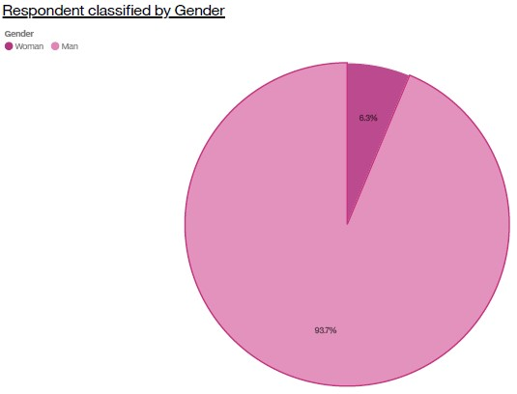
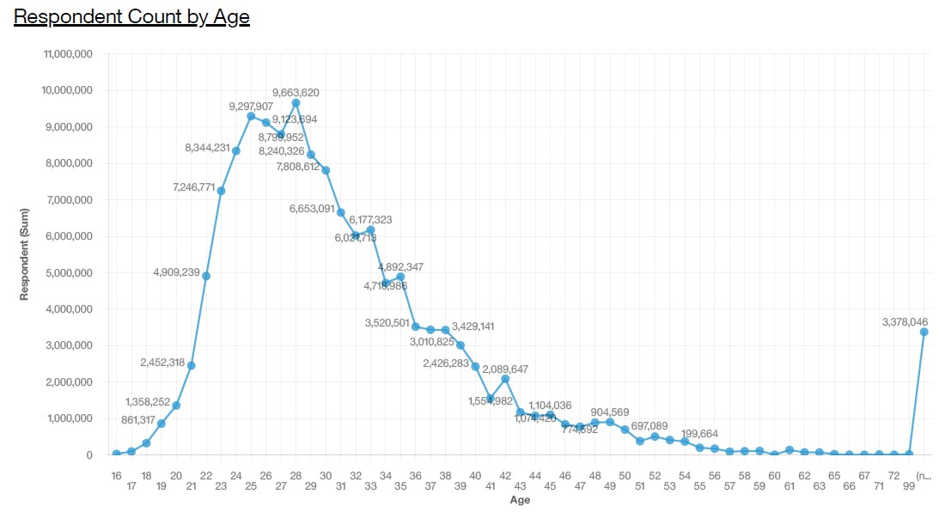
APPENDIX

Slide 19
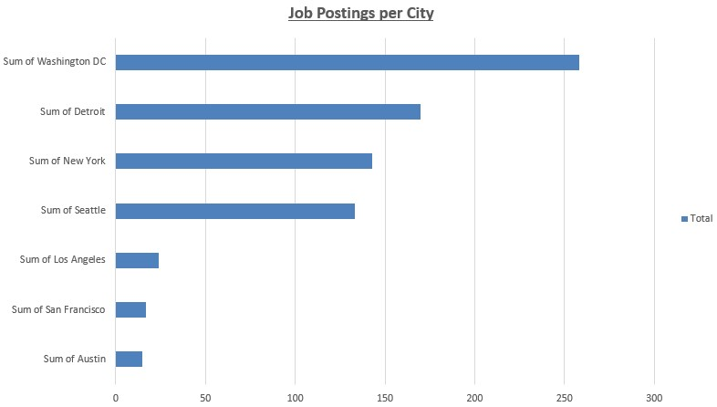
JOB POSTINGS

Slide 20
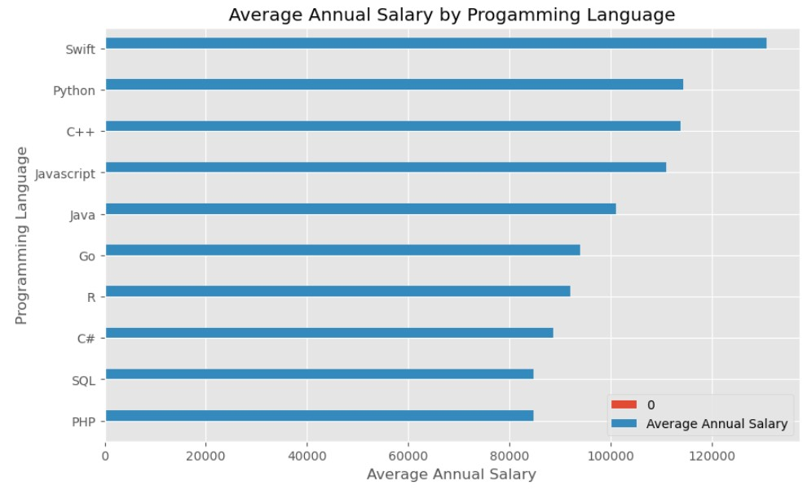
POPULAR LANGUAGES

